Slide 1

GWAS & Polygenic Scores 2016 Summer Workshop CEDUA El Colegio de Mexico, A. C.
Ben Domingue

Slide 2
Introduction

Slide 3
Schedule
LECTURE | HANDS-ON
Genome-wide data | Linux tools Starting with plink
Population stratification | More plink! Hapmap
Heritability | GCTA Other measures of relatedness
Polygenic Scores | Constructing polygenic scores PRSice
Looking forward | Creating a research agenda

Slide 4
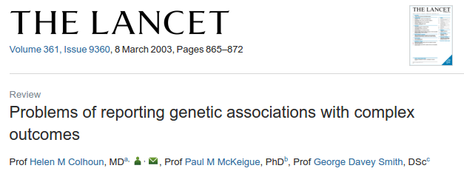
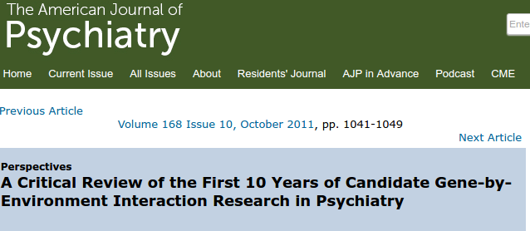
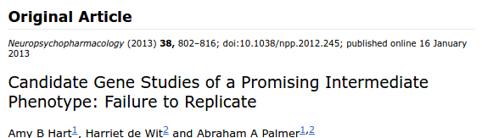

How do we link phenotypic variation to genetic variation?
First idea: candidate genes
A priori biological reason to suspect relevance.

Slide 5
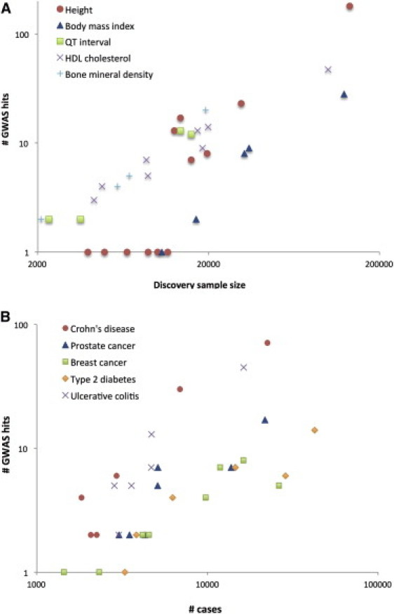
GWAS: basically data mining
Visscher et al., 2012
First, assemble LOTS of data.
Regress outcome on SNP + controls
Do this for every SNP
Look for SNPs that are sig after corrections for multiple testing (p<1e-8)

Slide 6
Theory of GWAS

Slide 7
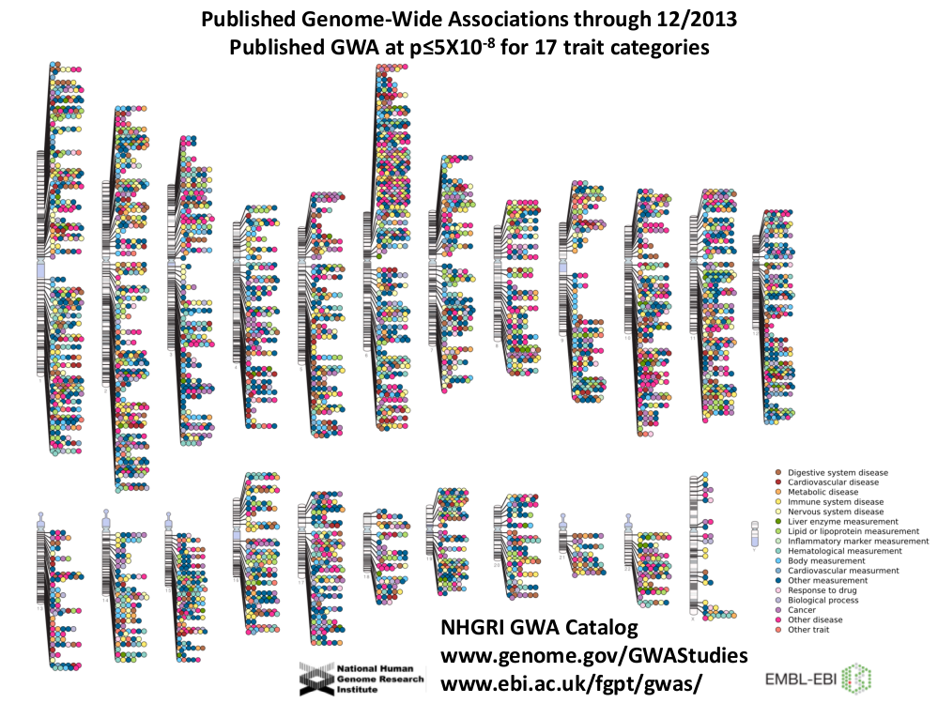

Slide 8
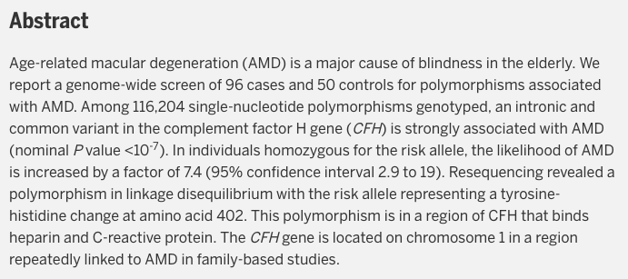
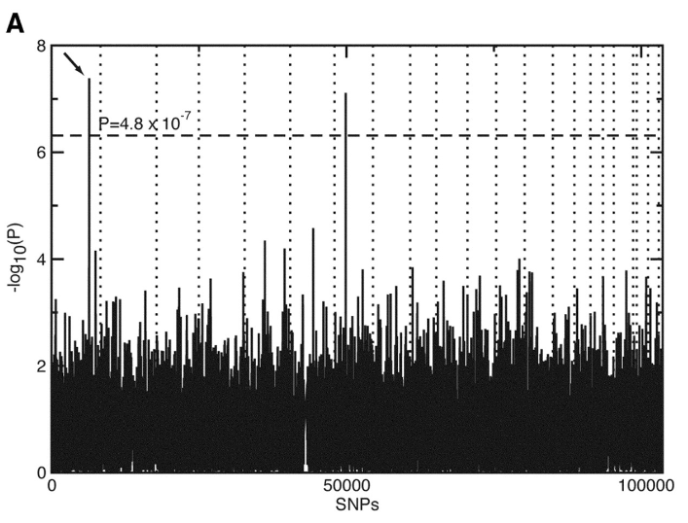
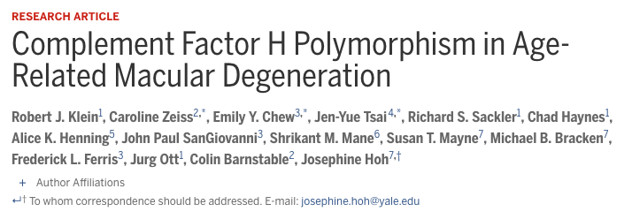
The first gwas

Slide 9
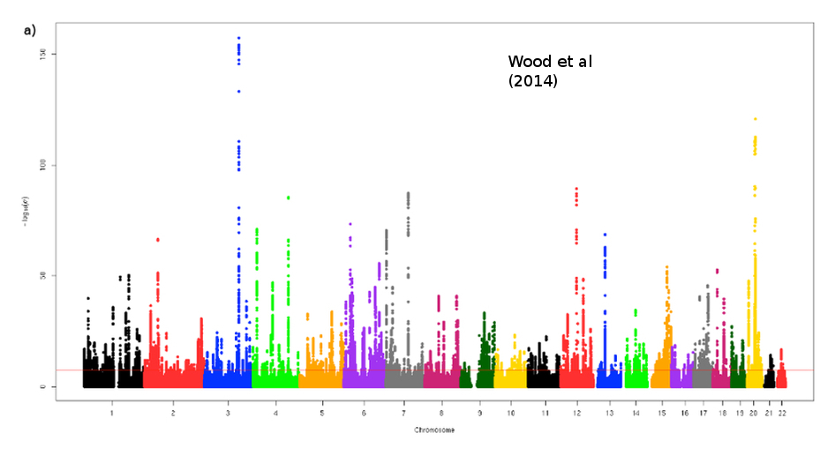
Height

Slide 10
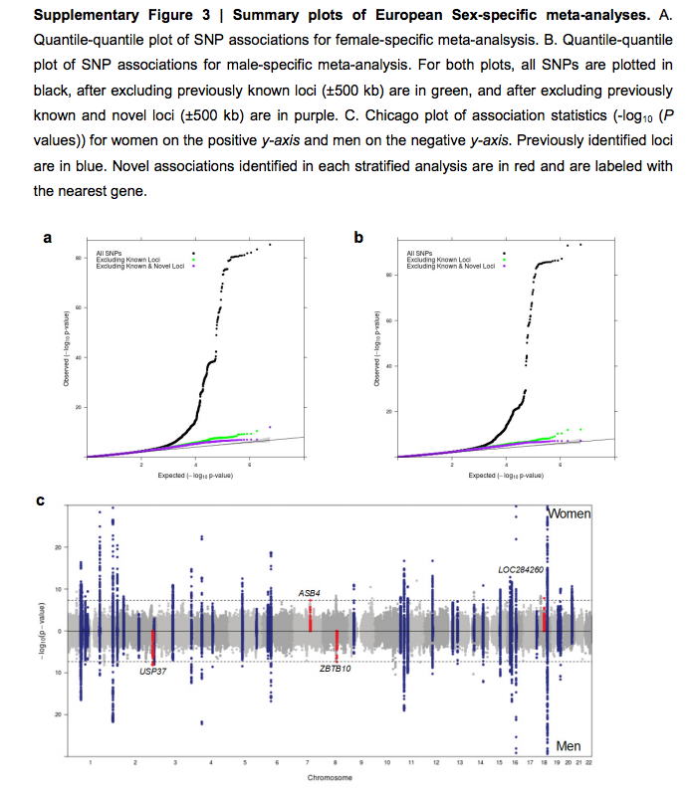
BMI (Locke et al 2015)

Slide 11
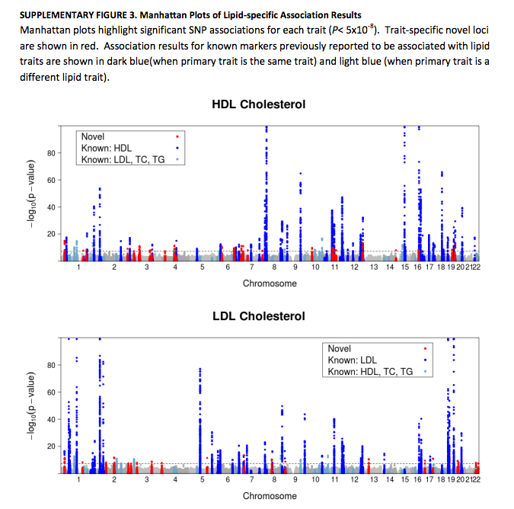
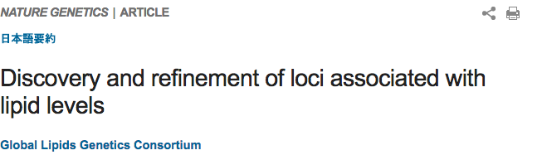

Slide 12
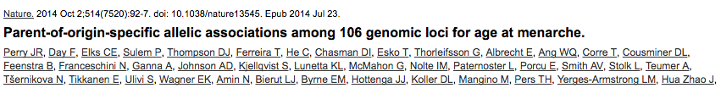
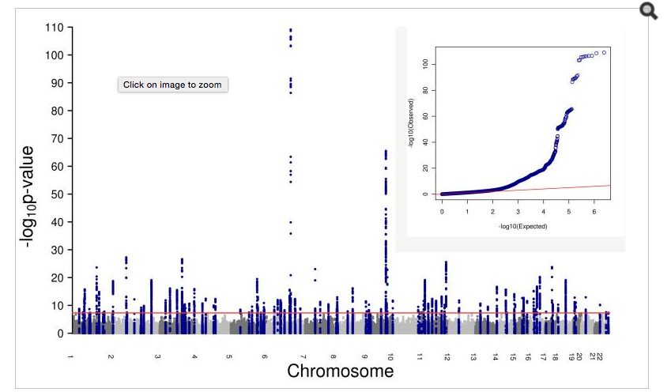

Slide 13
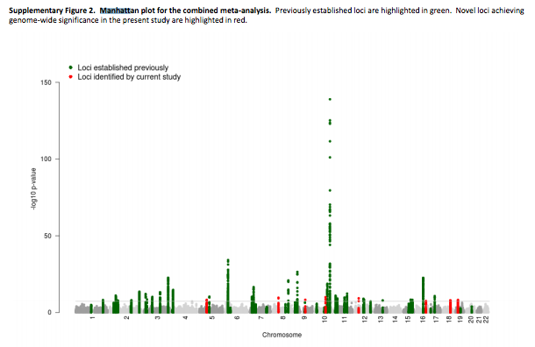
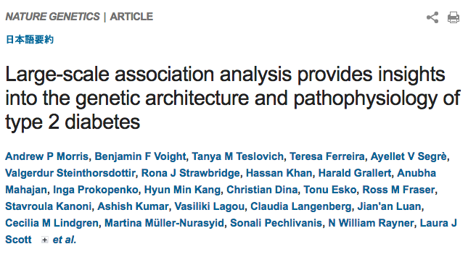

Slide 14
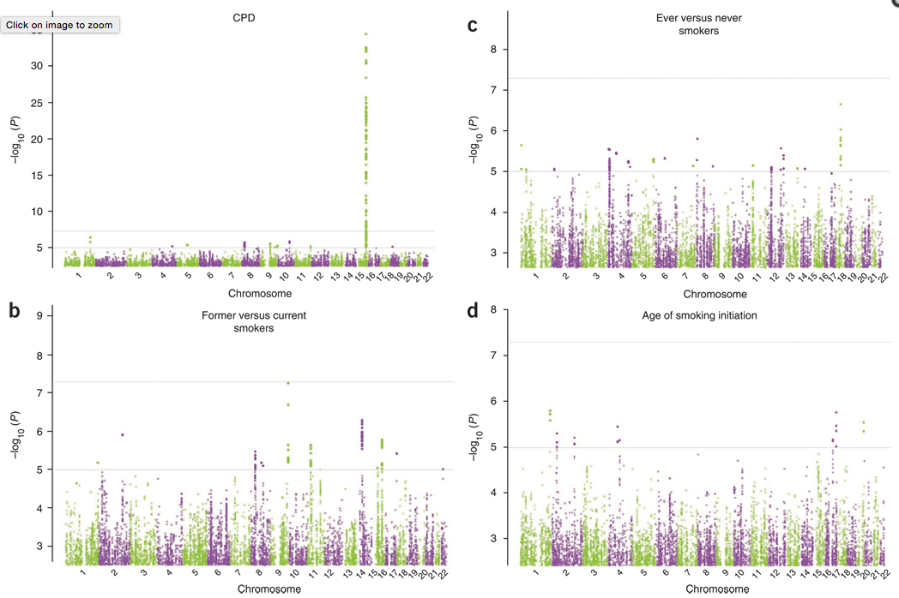
Smoking
Smoking

Slide 15
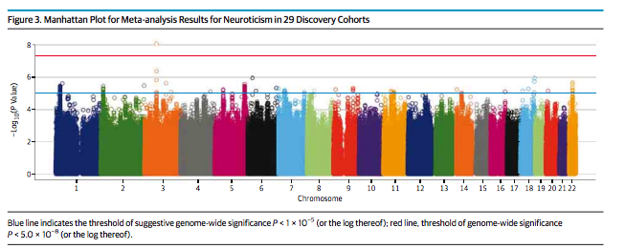


Slide 16
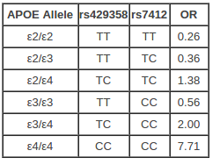
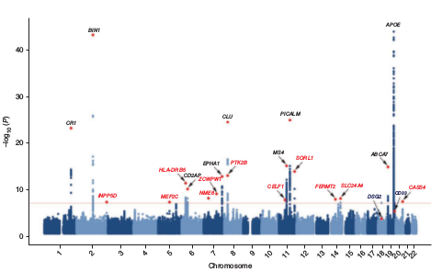
Alzheimer’s
Baseline risk:
9% M, 17% F
Source:
Genomes Unzipped
Lambert et al. 2013

Slide 17
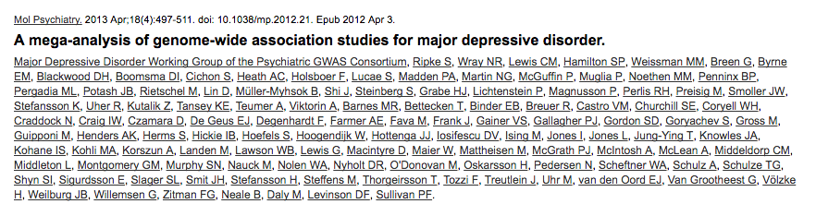
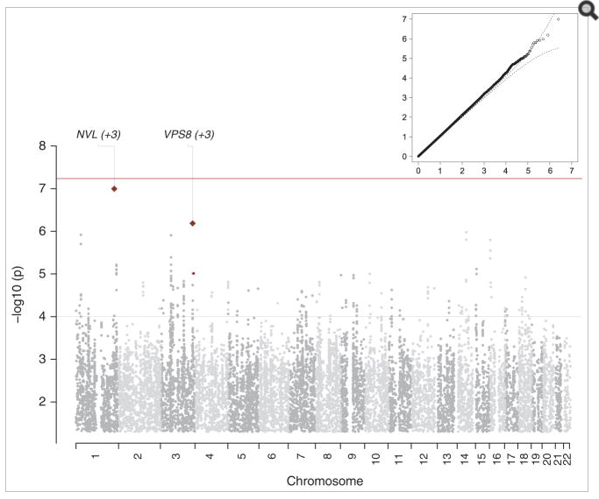

Slide 18
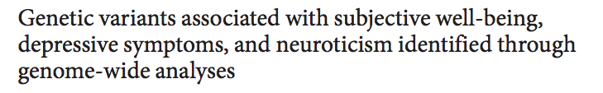
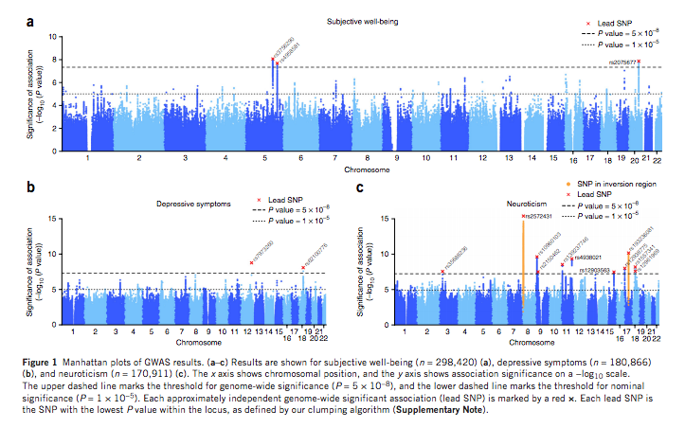

Slide 19
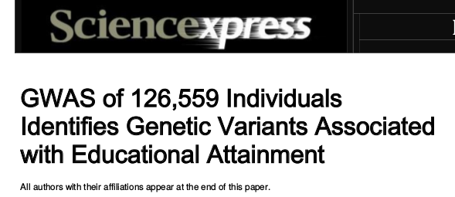
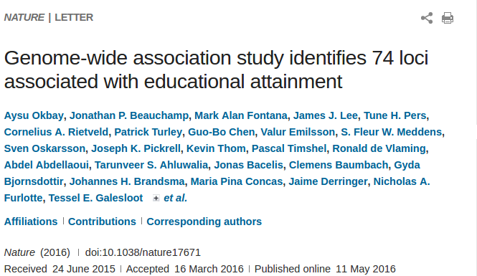
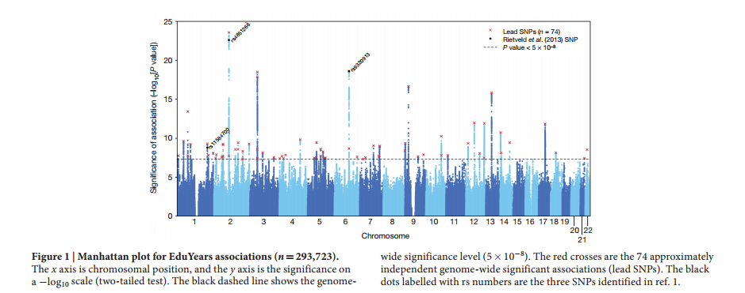
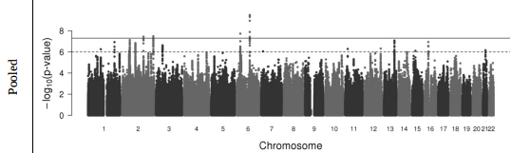
NEW!

Slide 20
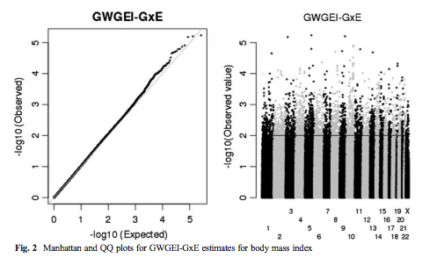
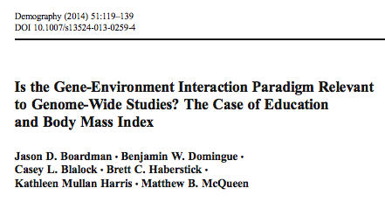
Why you shouldn’t do a gwas

Slide 21
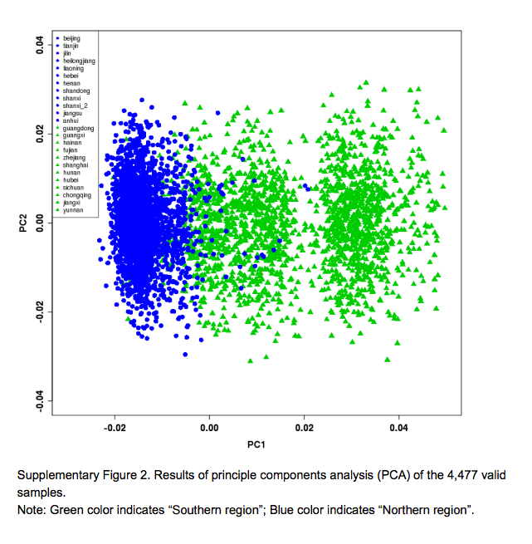
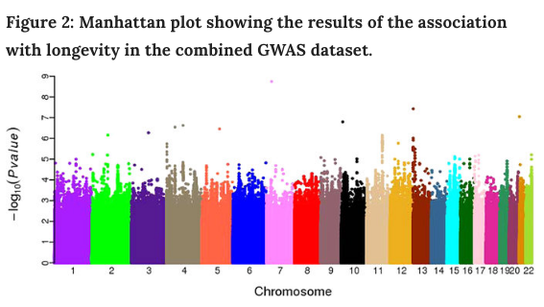
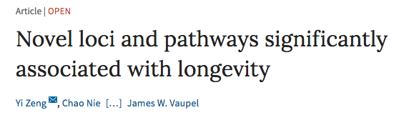
GWAS on non-European samples

Slide 22
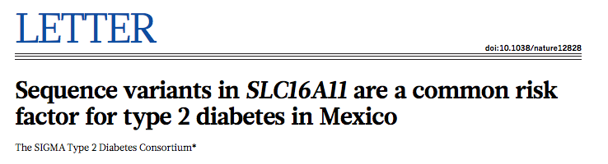
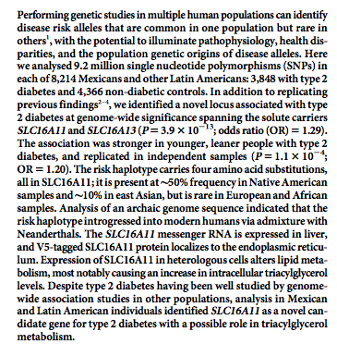

Slide 23
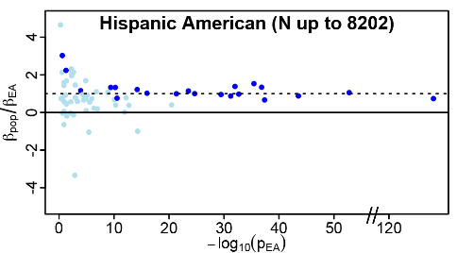
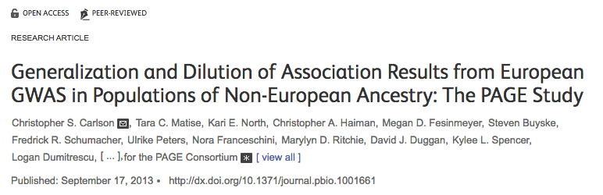
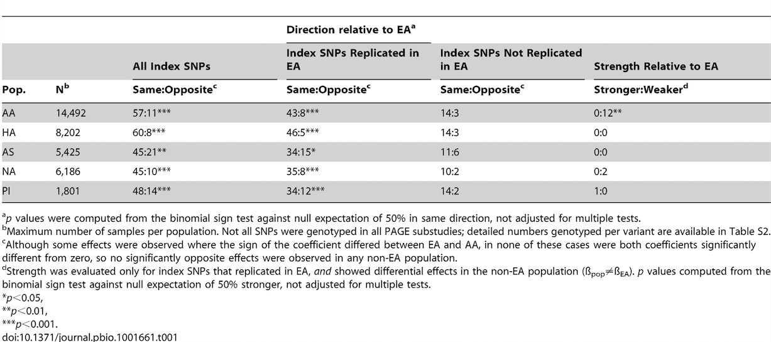

Slide 24
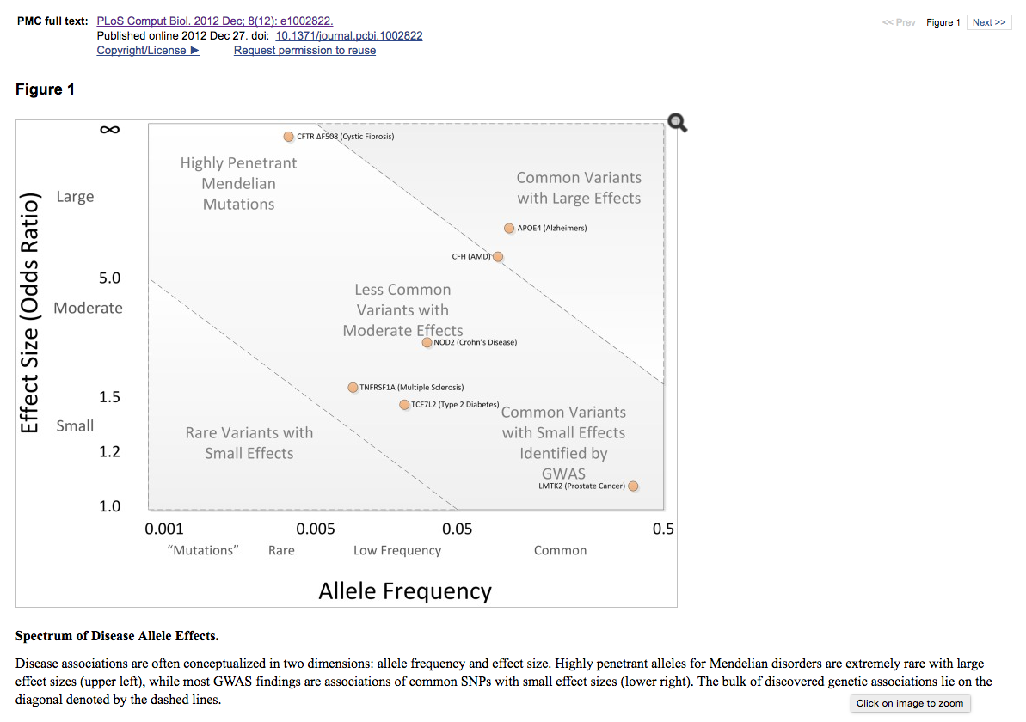
On genetic architecture

Slide 25
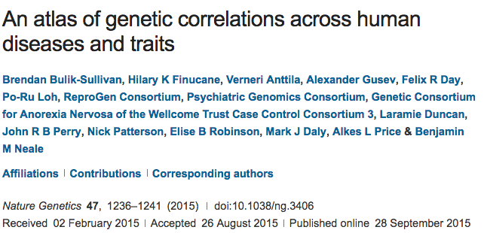
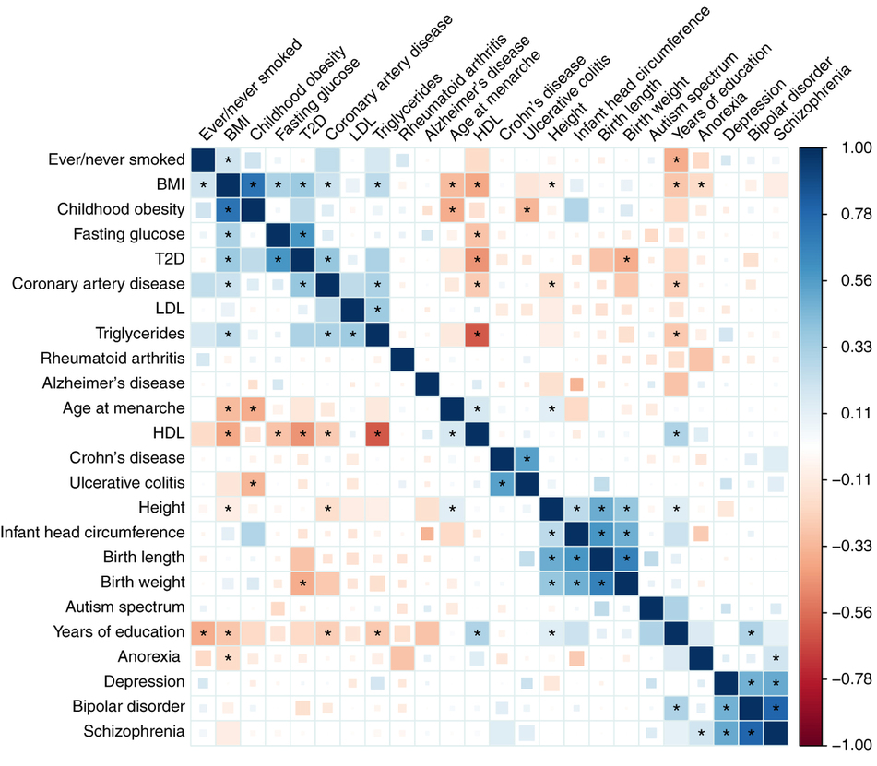
Overlapping genetic architectures

Slide 26
What are we going to do with GWAS data?
Going to demonstrate a potential line of research related to educational attainment.
Other stories could be told about bmi/smoking
BMI:
Within-family: http://journals.plos.org/plosone/article?id=10.1371/journal.pone.0101596
Cohorts: http://asr.sagepub.com/content/80/4/705.short
Development: http://archpedi.jamanetwork.com/article.aspx?articleid=1171937&goback=.gde_4173543_member_121667167
Behavioral moderators:
Sugary drinks http://www.nejm.org/doi/full/10.1056/nejmoa1203039
Fried foods http://www.bmj.com/content/348/bmj.g1610
Exercise http://journals.plos.org/plosmedicine/article?id=10.1371/journal.pmed.1000332
Smoking:
Cohorts: http://link.springer.com/article/10.1007/s10519-015-9731-9
Development: http://archpsyc.jamanetwork.com/article.aspx?articleid=1672838&resultclick=3
Environmental moderators: http://www.nature.com/tp/journal/v3/n8/abs/tp201363a.html

Slide 27
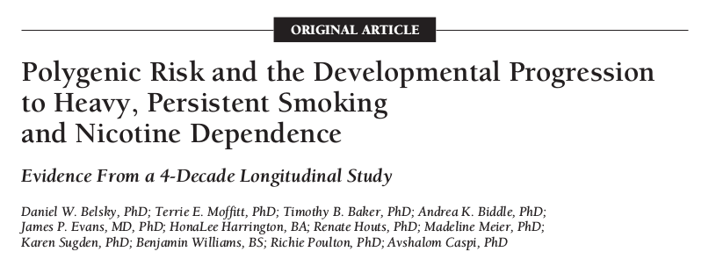
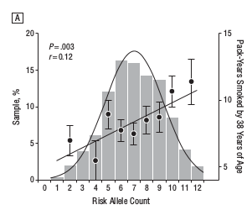
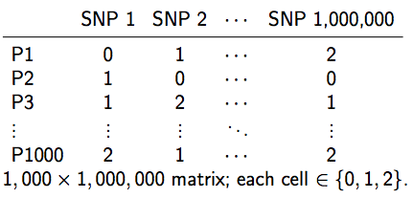
Polygenic Scores (PGS)
Like a credit score
+
They are predictors of the type we are accustomed to.
Prediction >> Description
Going to turn to issues related to PGS for EA
Question 1: how robust is their prediction?

Slide 28
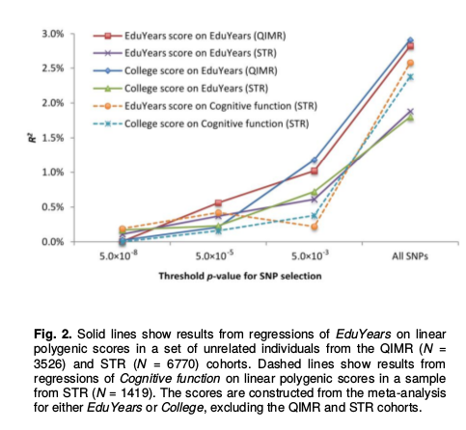
Predict out of sample
Important point given the failures of candidate gene studies!

Slide 29
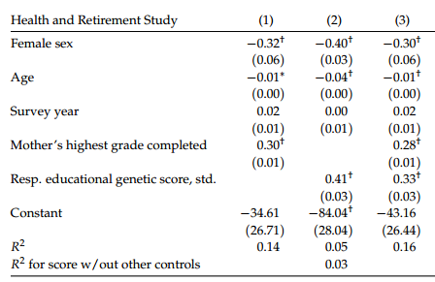
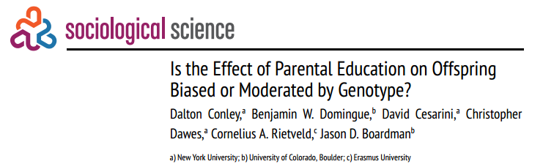
Predicts net of mom’s education

Slide 30
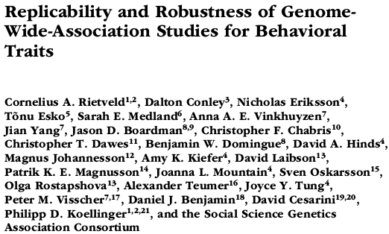
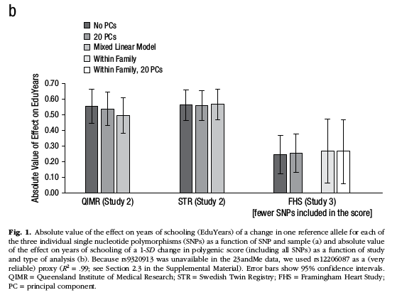
Predicts within families

Slide 31
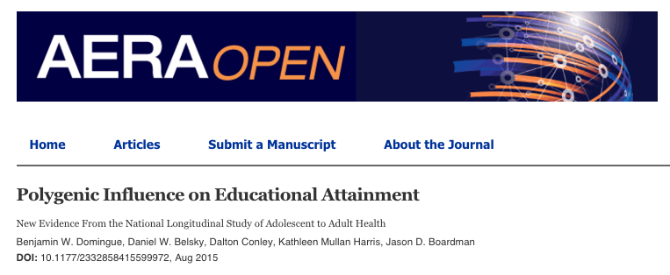

Predicts within families.

Slide 32


Predicts academic performance

Slide 33

One obvious pathway from genetics to educational attainment is cognition.

Slide 34


But there are other candidates.

Slide 35
I’ll talk more about research possibilities related to polygenic scores later this week.
I’m currently pursuing a number of projects, talk to me if interested!
Now let’s talk about construction.

Slide 36
PGS types
Top hits: only SNPs that reach some (stringent) level of statistical significance (1e-8)
Genome-wide: all SNPs or all below some nominal level of significance (0.5)

Slide 37
Hopefully you have some interesting ideas for how to use a PGS (or at the very least have been inspired to think about how one might use them).
But where do they come from?

Slide 38

Constructed by “others”
But you are limited to what they have available (can’t use new or updated results).

Slide 39
What about making your own?
Hopefully you’ll leave today equipped to do so!

Slide 40
Some things to be mindful of before we get started.
Additivity
Strand Ambiguity
Weights
LD considerations

Slide 41

Additive Model of Genetic effects
In general, GWAS attempt to identify additive (as opposed to dominant or recessive) genetic effects.

Slide 42

Ambiguous strands

Slide 43

GWAS Results
Empirical Data
1 rs3934834 0 1005806 A G

Slide 44

Strand issues
Paired bases: A-T, C-G
Fwd strand A/C implies reverse strand T/G
Suppose GWAS identifies A as risk allele. [note: they may not give you other allele.]
Your data:
What base in your data will be equated to the A in GWAS results?

Slide 45
Strand issues
In “top hits” scores, you can try to determine what is going on via comparison of allele frequencies to some kind of reference.
Authoritative info hard to come by (and needs to be population specific).
Not going to work if allele frequencies aren’t easily distinguished.
Very nasty issue, but I have some workarounds.

Slide 46
Weights
Each SNP will be weighted by the magnitude of its effect.
For continuous traits, the estimated coefficient.
For dichotomous traits, log of the OR.
If you’re doing a top-hits score, then may not need to weight.

Slide 47

LD considerations
Too many variants in linkage with a certain causal variant could lead to overemphasis of that region in the PGS
Instead of LD pruning, LD clumping:
Select variants in LD blocks that are most highly associated with outcome.
LDpred:

Slide 48
Research #3
Before we look specifically at how to make scores, let’s take a new look at research projects.
Data access is likely to be an issue. Outline the steps one may need to go through to get access to the data of interest.

Slide 49

Let’s make some scores
We are going to make scores using some of my homemade software:
https://github.com/ben-domingue/HeritHelper
Other options exist:

Slide 50
Outline top hits score construction

Slide 51

C1_pgs_top_hits.R
Pruning for top hits
Ditching ambig SNPs
Construct score with plink
Checking out results

Slide 52

C1_pgs_top_hits.R
We went from 4444 to 3826.

Slide 53
Please run the C1_pgs_top_hits.R script.
Aim is to understand the mechanics of what is happening as well as the substantive implications.

Slide 54
Outline the call to make_pgs

Slide 55

make_pgs()
Homebrewed function to create a pgs.
Available at https://github.com/ben-domingue/HeritHelper/blob/master/R/make_pgs.R

Slide 56
Explain make_pgs
How deep you go here is going to depend on how much fun you have wading through R code.
Specifically R code being used as a wrapper for calls to plink and other busy work.
If you want to walk through it, use debug(make_pgs) and then run the function.
We’ll walk through the main points as a group.

Slide 57
4 Step process
Remove ambig SNPs from the GWAS file.
Clumping
Remove ambig SNPs and those removed in step 2 from plink files.
Generate polygenic score
Step 3 is really messy.

Slide 58
Step 3. Cleaning plink files
Remember that the goal is to exert maximum possible control over what is happening.
Get rid of clumped SNPs
Eliminate ambig SNPs
“Force” everything to A/C
Flip effect if necessary
Revert to original SNP coding (undo #3)

Slide 59


Quick use of make_pgs()
-Won’t work on EC2 easily, but you should be able to install on your machine or server.
-You can also download the package directly from github and install without the devtools package.
-If you are really interested in this option but these things sound complicated, please talk to me.

Slide 60

Using make_pgs
Get gwas results
Create genome-wide score without clumping

Slide 61
Let’s check in on ambig SNPs
# in GWAS results: 2 554 638
# in plink file: 406 123
# common: 375 285
# used to create risk score: 327 797

Slide 62

Clumped score
Restrict gwas results to only those snps in our .bim file.
Make clumped score!

Slide 63
Caveats before labwork
Polygenic Scores only capture GWAS variants
Common variants
Relatively constant prediction across environments
Conservative method for testing GxE
I’m not an expert on working with imputed data, but this will require some modifications to the workflow we’ve used here.

